Slide 1
Bellabeat: Product Analysis
Presented By: Krish Verma

Slide 2
What are we talking about ?

Slide 3
Business Task
Analyze how consumers are using the products: Time and Leaf Urban based on calories, steps and intensity.

Slide 4
Parameters and DataViz

Slide 5
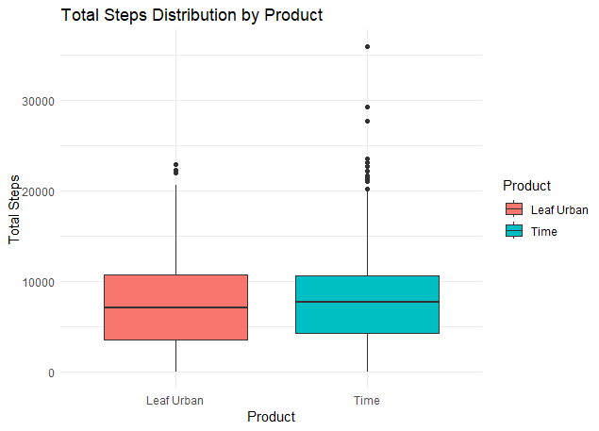
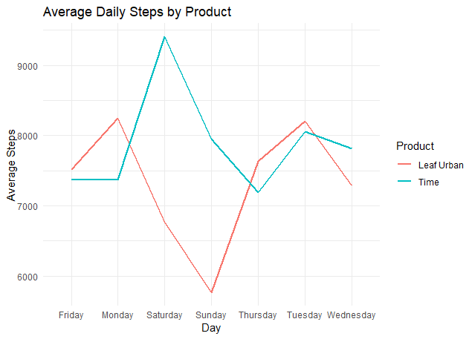
Steps
The median and mean steps for the products are roughly similar though their distribution is very different
Time users prefer doing activity/ going out on weekends while Leaf Urban users prefer staying at home
Leaf Urban users have a relatively higher step count on weekdays

Slide 6
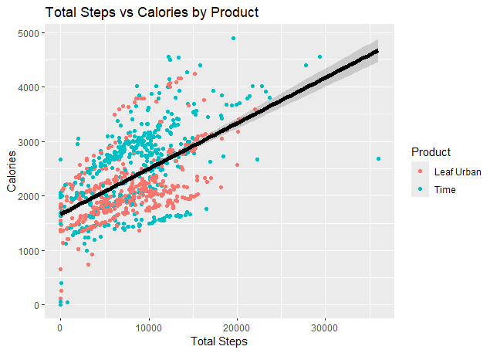
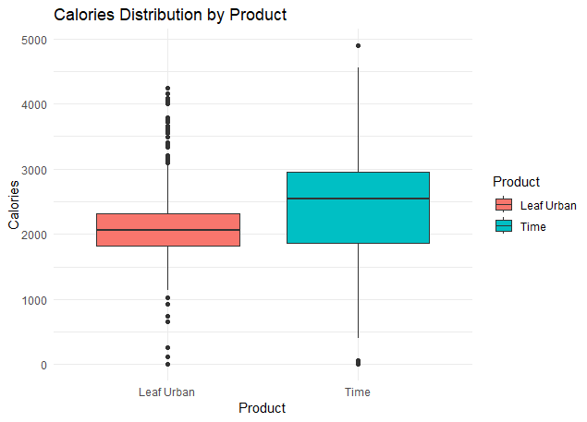
Calories
Positive correlation between steps and calories
Time users burn 321 more calories on average in a day
Time users have a wider spread, thus a significantly higher median
For the same number of steps, most time users have higher calories burnt

Slide 7
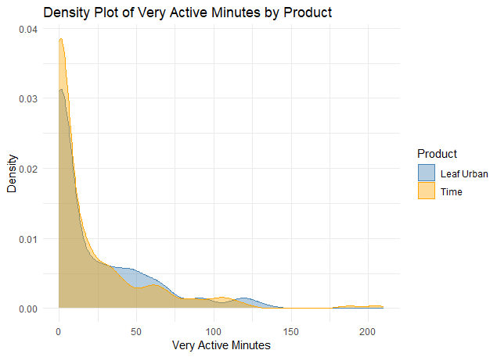
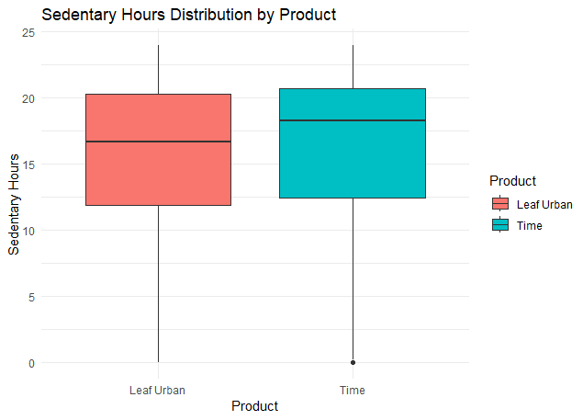
Intensity: Active Minutes and Sedentary Hours
Most users are highly active only for 0-30 mins in a day
Leaf Urban users are highly active for 22 mins on average, a minute higher than Time users
Leaf Urban users have lower average and median sedentary hours at 16.1 hr and 16.7 hrs
Active minutes and Sedentary hours exhibit negative correlation

Slide 8
Conclusion

Slide 9
Conclusions
1
2
3
Steps are highest on weekends for Time users
Average combined number of steps per day are 7368
Leaf Urban users burn less calories on average
Mean combined calories burned in a day are 2304
Leaf Urban users are more active
Leaf Urban users have a less sedentary lifestyle

Slide 10
Thank You

